Slide 1















RMS: Recipe Management System

Slide 2

Team Members
Ajay Das
Adithya Vinod
Adwaid Manoj
Anamika S

Slide 3

Introduction
RMS simplifies recipe management, allowing users to create, store, and share recipes. Our user-friendly platform caters to both experienced chefs and home cooks, enabling them to organize recipes into categories and create custom recipe books. RMS features

Slide 4
RMS: Recipe Management System
Recipe Management: RMS is a web application that helps users create, store, and share recipes. Users can organize their recipes into categories and create custom recipe books.
User Experience: RMS is designed to be user-friendly and intuitive. It features a clean and modern interface, making it easy to navigate and find the information you need.
Community Features: RMS fosters a community of food enthusiasts. Users can share their recipes, follow other users, and rate and comment on recipes.
Technology Stack: RMS is built using a robust technology stack, including a MySQL database, a Node.js backend, and a React frontend. This ensures scalability, reliability, and performance.

Slide 5
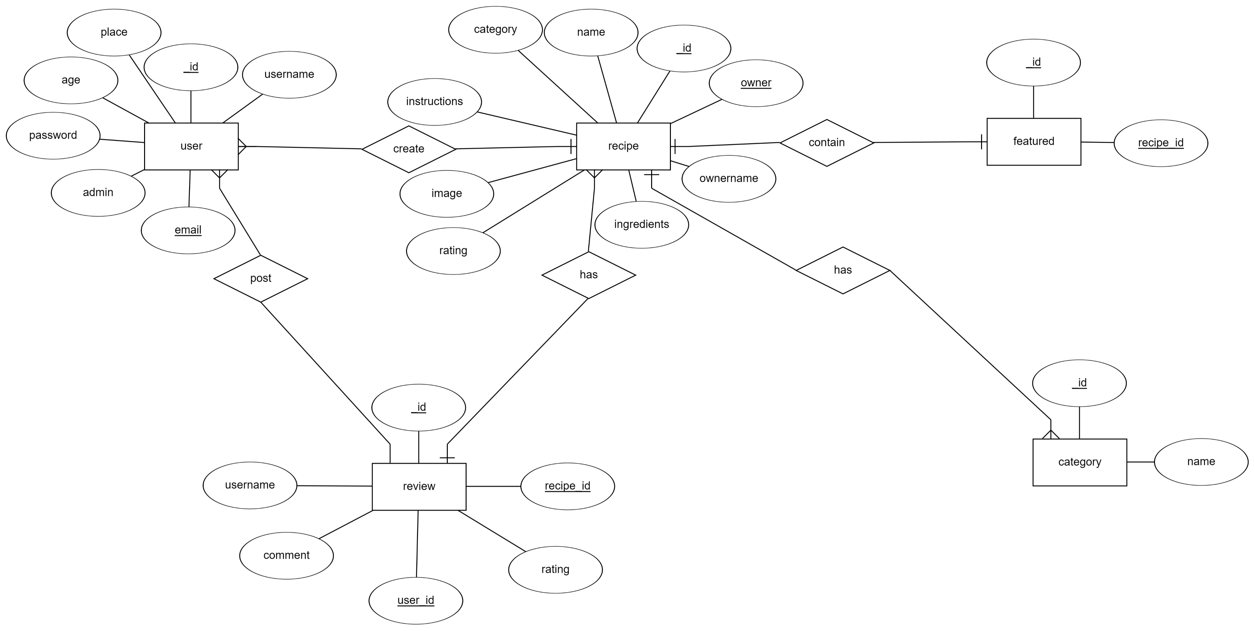
ER Diagram

Slide 6
Provide users with the tools to easily create, edit, and manage their own recipes, allowing them to showcase their culinary creativity.
01.
Objectives
Cusiny is an innovative online platform dedicated to food enthusiasts who love to explore, share, and manage recipes. It provides users with the ability to create, modify, and categorize their own recipes, ensuring a personalized culinary experience. Users can also engage with the broader community by browsing, rating, and commenting on recipes shared by others. The homepage features a curated carousel of top-rated and featured recipes, while the platform's sorting options allow for easy navigation based on food categories.
Ensure the platform remains safe and user-friendly by allowing admins to manage user profiles effectively while respecting user privacy by restricting access to passwords. These passwords are also encrypted.
02.
Encourage users to explore diverse recipes and food categories, broadening their culinary horizons and discovering new tastes and techniques using a search bar.
03.

Slide 7

Creation Process
Front-End Development:
ReactJS Development: We built dynamic and interactive user interfaces using ReactJS. This involved creating reusable components, managing state, app context and ensuring a smooth user experience. Data is also stored locally.
Back-End Development:
Database Management with MongoDB: We handled the setup and management of the database using MongoDB, ensuring that user data, recipes, and other essential information were stored securely and efficiently.
Server-Side Logic with Express and Node.js: We developed and managed the server-side logic using Express and Node.js, allowing for seamless communication between the front-end and the database, and enabling key functionalities such as user authentication, recipe management, password eand admin controls.

Slide 8
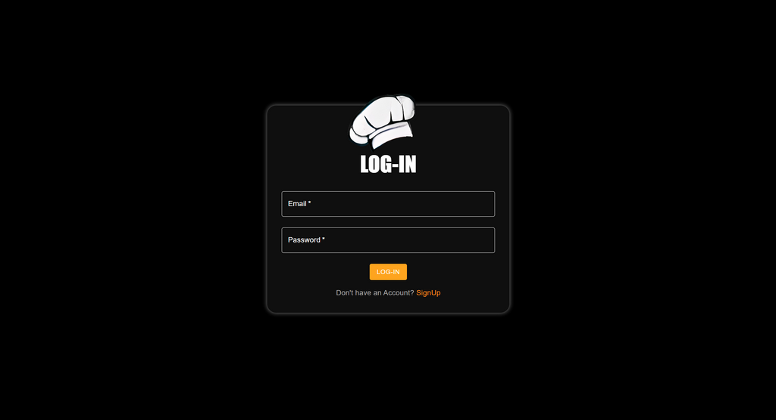
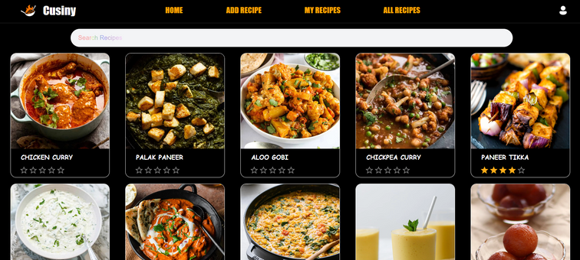

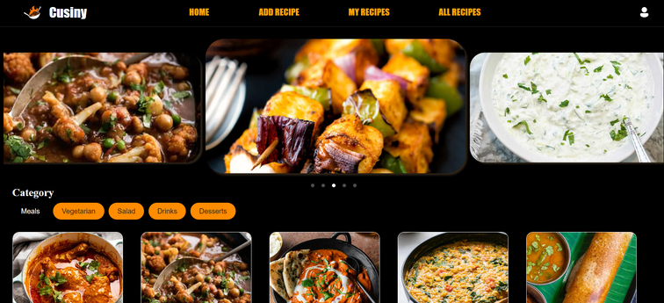
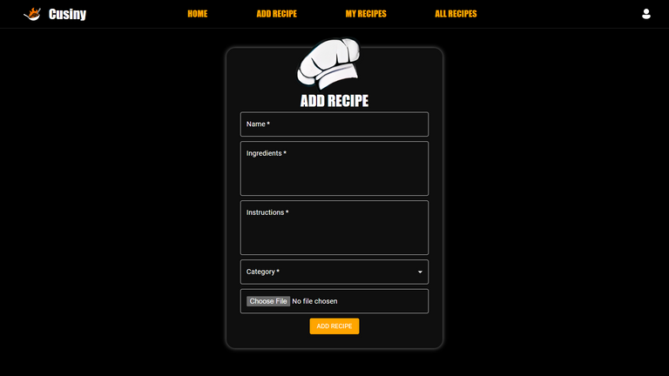
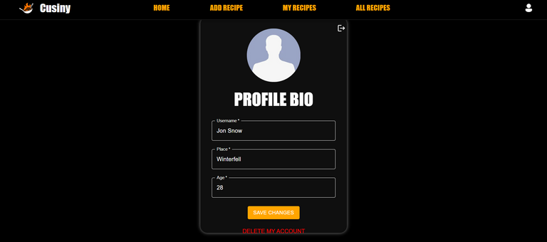
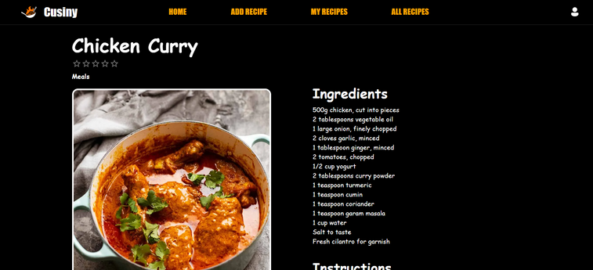
Final
Product
Exploring creativity

Slide 9

Future work
Threats
Add user profiles with personalized recipe recommendations
Implement social media sharing features
Enable recipe video uploads and tutorials
Develop a mobile app version for easier access
Competition from established recipe platforms
Security risks from user data management
User retention challenges if features aren’t regularly updated
Strengths
Opportunities
User-friendly interface
Robust recipe management features
Strong community engagement through ratings and comments
Expand to include personalized recommendations
Integrate social media sharing
Launch a mobile app version

Slide 10

Results
Successful Launch: Cusiny was developed and launched with full functionality, including user authentication, recipe management, and community features.
User Engagement: Enabled users to interact by adding, editing, and rating recipes, fostering community engagement.
Efficient Design: Created a responsive, user-friendly interface inspired by MUI, ensuring a smooth user experience.

Slide 11
Thank you very much!
www.reallygreatsite.com

